Slide 1
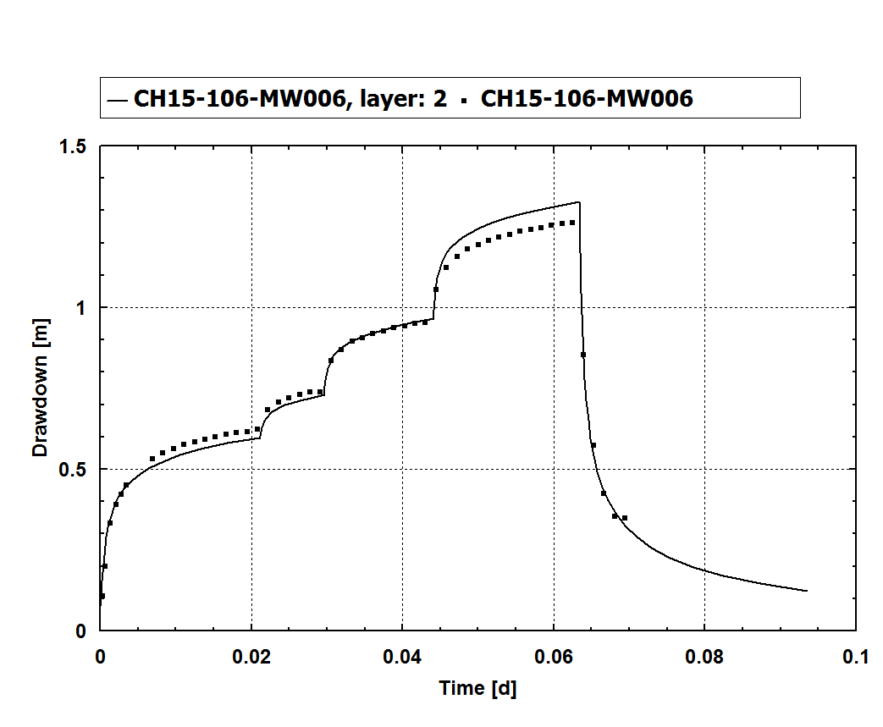
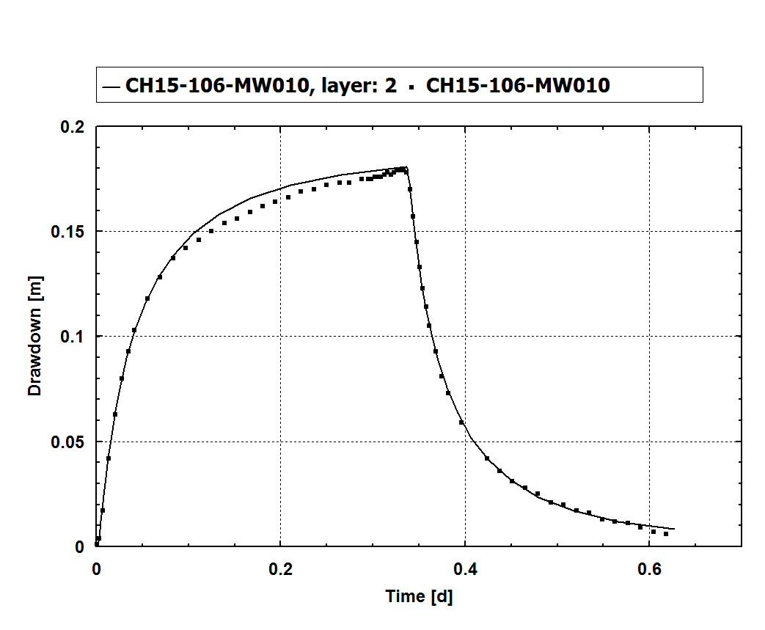
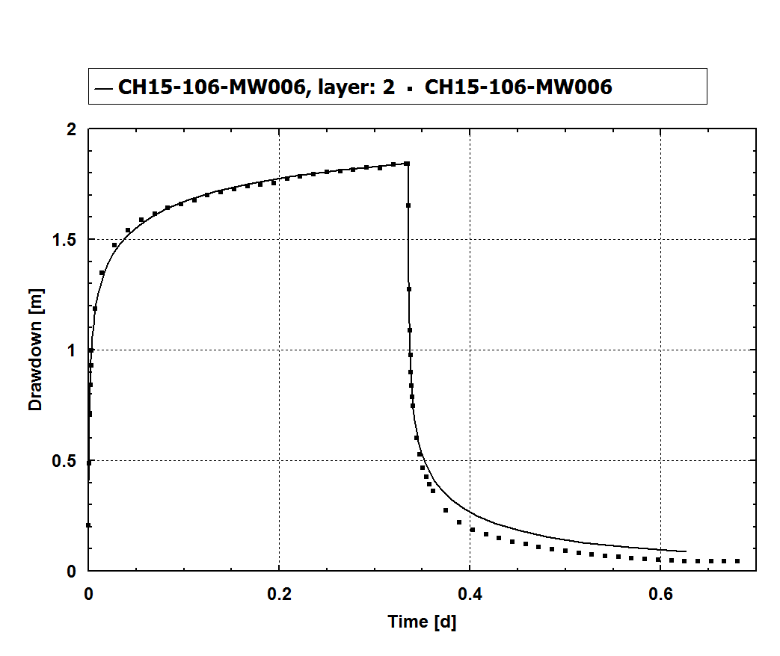
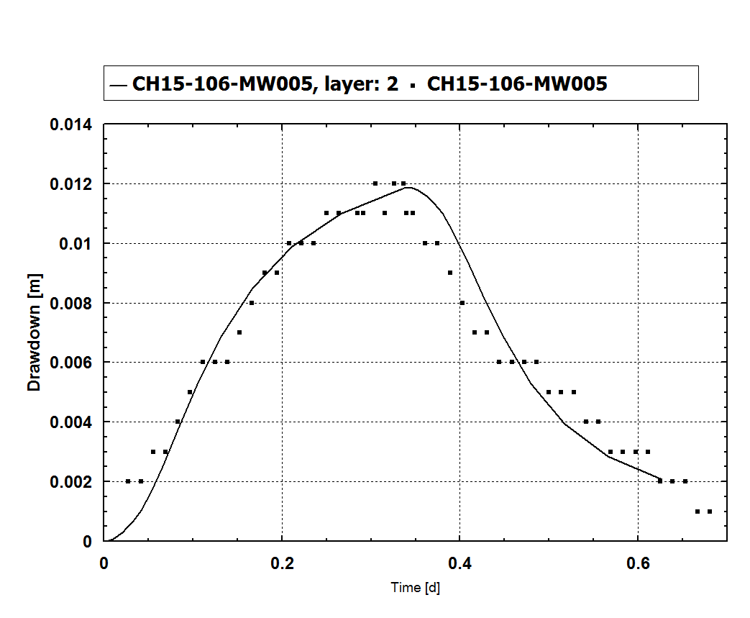

Observation Well,
Constant Rate Test
Pumping Well, Step Test
Pumping Well,
Constant Rate Test
Observation Well,
Constant Rate Test
Notes:
Scale of Y axis is variable.
Continuous lines are simulated (model) results and point values are observed (field) data.
FIGURE 6
SIMULATED AND OBSERVED DRAWDOWN
FCD, WELL CLUSTER 3
Faro Mine Remediation Project

Slide 2
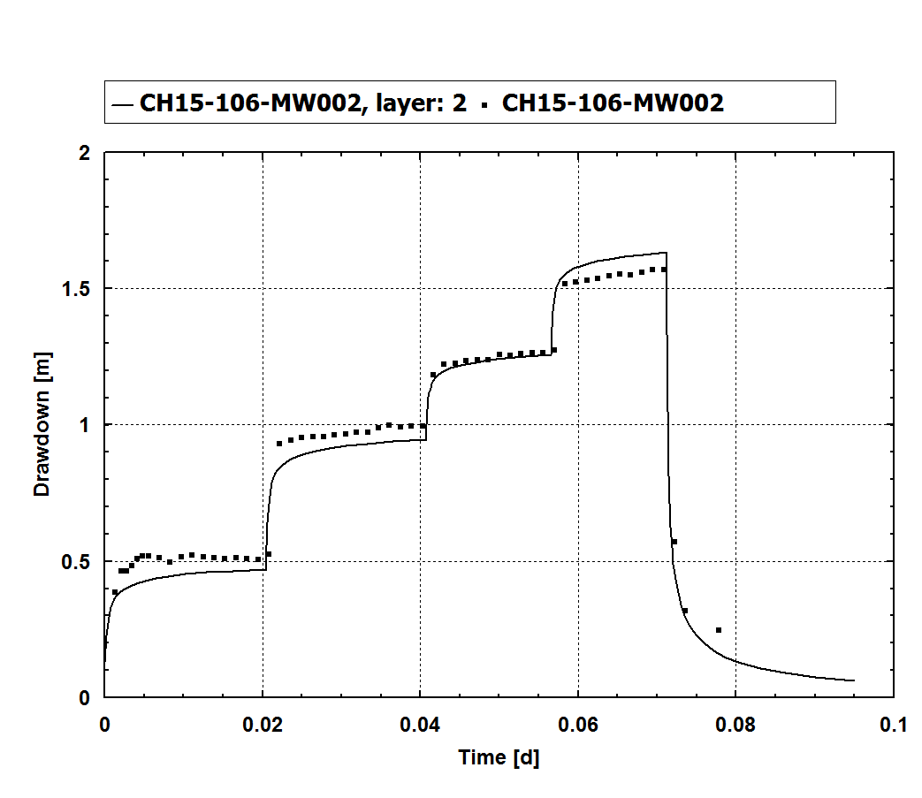
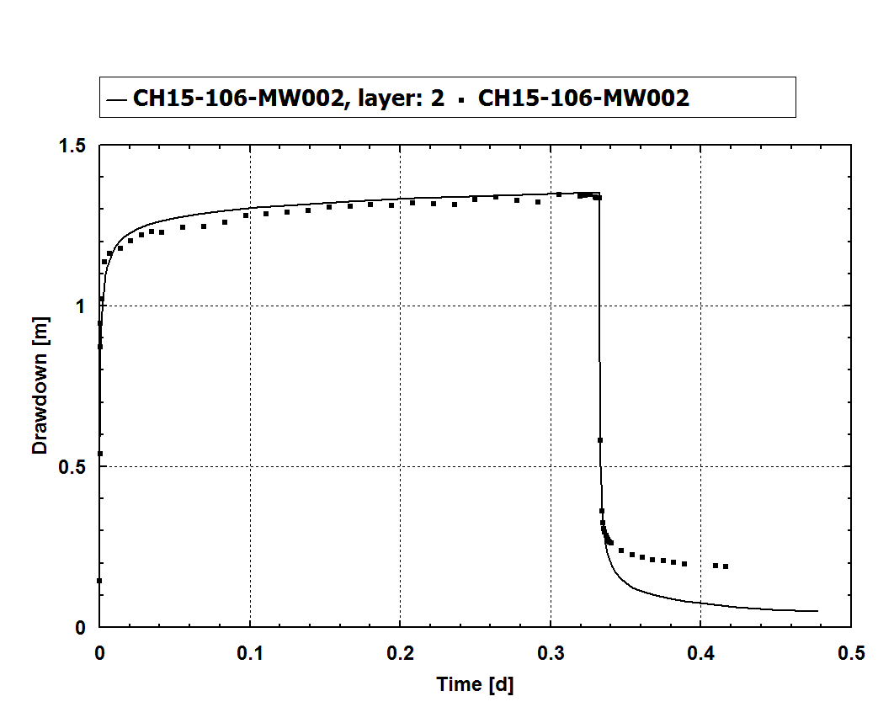
Step Test
Constant Rate Test
Notes:
Scale of Y axis is variable.
Continuous lines are simulated (model) results and point values are observed (field) data.
FIGURE 5
SIMULATED AND OBSERVED DRAWDOWN
FCD, WELL CLUSTER 1
Faro Mine Remediation Project

