Slide 1
Wildwood Exploration Inc.
Reindeer (REI) Project, YT
Geophysical studies
Ground Penetration Radar (GPR)
Prepared By:
GroundTruth Exploration Inc.
Dawson City, YT
Report #: WW-REI-GPR20-Rev0 Jan. 20, 2025
Author: Amir Radjaee, P.Geo.

Slide 2

Outline:
Introduction
Data processing and Results
Conclusion and recommendations
Deliverables
References

Slide 3
Introduction:
GroundTruth Exploration has completed GPR surveys on the Reindeer (REI) placer exploration property. The field work was performed from October 5, 2020. Total coverage of the survey amounted to 1,175 line-meter along 4 survey lines, including 585 line-meter with 80 MHz and 590 line-meter with 160 MHz GPR systems. This presentation report describes the survey, results and examples for preliminary interpretation of GPR depth sections.
Although GPR has been attempted historically at various placer sites, newly developed measurement techniques such as HDR (High Dynamic Range) have enabled greater utilization of GPR by collecting precise and high-resolution data. This study aims to evaluate the feasibility of different GPR systems and frequencies in placer gold exploration sites. By correlating the radar reflectors to known geological features detected by boreholes, GPR has been used for a preliminary exploration of complex paleochannel systems.
GPR is an obvious candidate for alluvial gold and diamond resource exploration in aggregate-filled paleochannels. GPR works based on transmitting an electromagnetic pulse in the radar frequencies range (between 10 MHz and 3 GHz) into the ground and recording the travel-time of reflections caused by contrasts in dielectric properties stratigraphic boundaries or diffracted by discrete objects like boulders. Previous studies have shown that GPR data reliably identifies the contacts between frozen and thawed zones in permafrost regions as well as mapping the bedrock surface and sedimentary stratigraphy of placer deposits.

Slide 4
Introduction:
Attenuation of the radar signal and resolution of the GPR section are the main challenges in GPR surveys. Attenuation defines the continuous loss of amplitude that a wave experiences as it propagates through a particular medium. The rate at which the amplitude decreases is referred to as the attenuation constant, which depends on the physical properties of the media such as electrical conductivity. The attenuation increases with the increase of frequency. The vertical resolution is usually considered to be approximately one-quarter of the wavelength of the radar wave. The vertical resolution also increases by increasing antenna frequency. Therefore, there is an inherent tradeoff between vertical resolution and penetration, and depending on the application and survey objectives, the desired antenna frequency must be selected accordingly. So, a direct comparison between 80 MHz and 160 MHz GPR antennas is made in this study.
Data were acquired using two different GPR systems supplemented by different antenna frequencies. The GPR systems applied (Figure 1) are described as follows:
  MALA GX HDR system developed by ABEM with 80 MHz, 160 MHz shielded antennas and an integrated DGPS for more accurate positioning. The GPR data were processed using the RadExplorer GPR processing software.
  PulseEKKO PRO and Ultra systems developed Sensors and Software with 50, 100 and 200 MHz central frequency antennas. Radar signals were processed and analyzed by the EKKO view deluxe software.

Slide 5
Introduction:
For the MALA GX, the survey was performed in two measuring modes, continuous readings at constant time intervals of 0.3sec, and separate readings at constant distance intervals of 10cm using an odometer wheel.
For the PulseEKKO system, measurements were conducted using the Common Mid-Point (CMP) method for velocity profile estimation of radar waves for depth conversion. Due to GPS malfunction issues, no line survey was performed.
The survey parameters and measuring modes are summarized in Table 1. The outline of the survey area and layout of lines for the northern and southern lines of the REI project is shown in Figure 2.

Slide 6
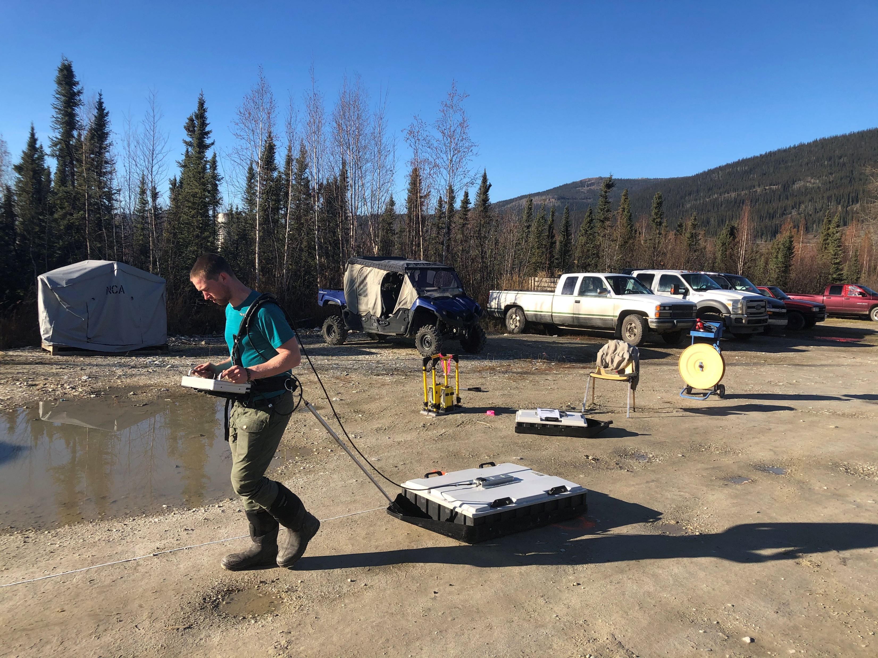
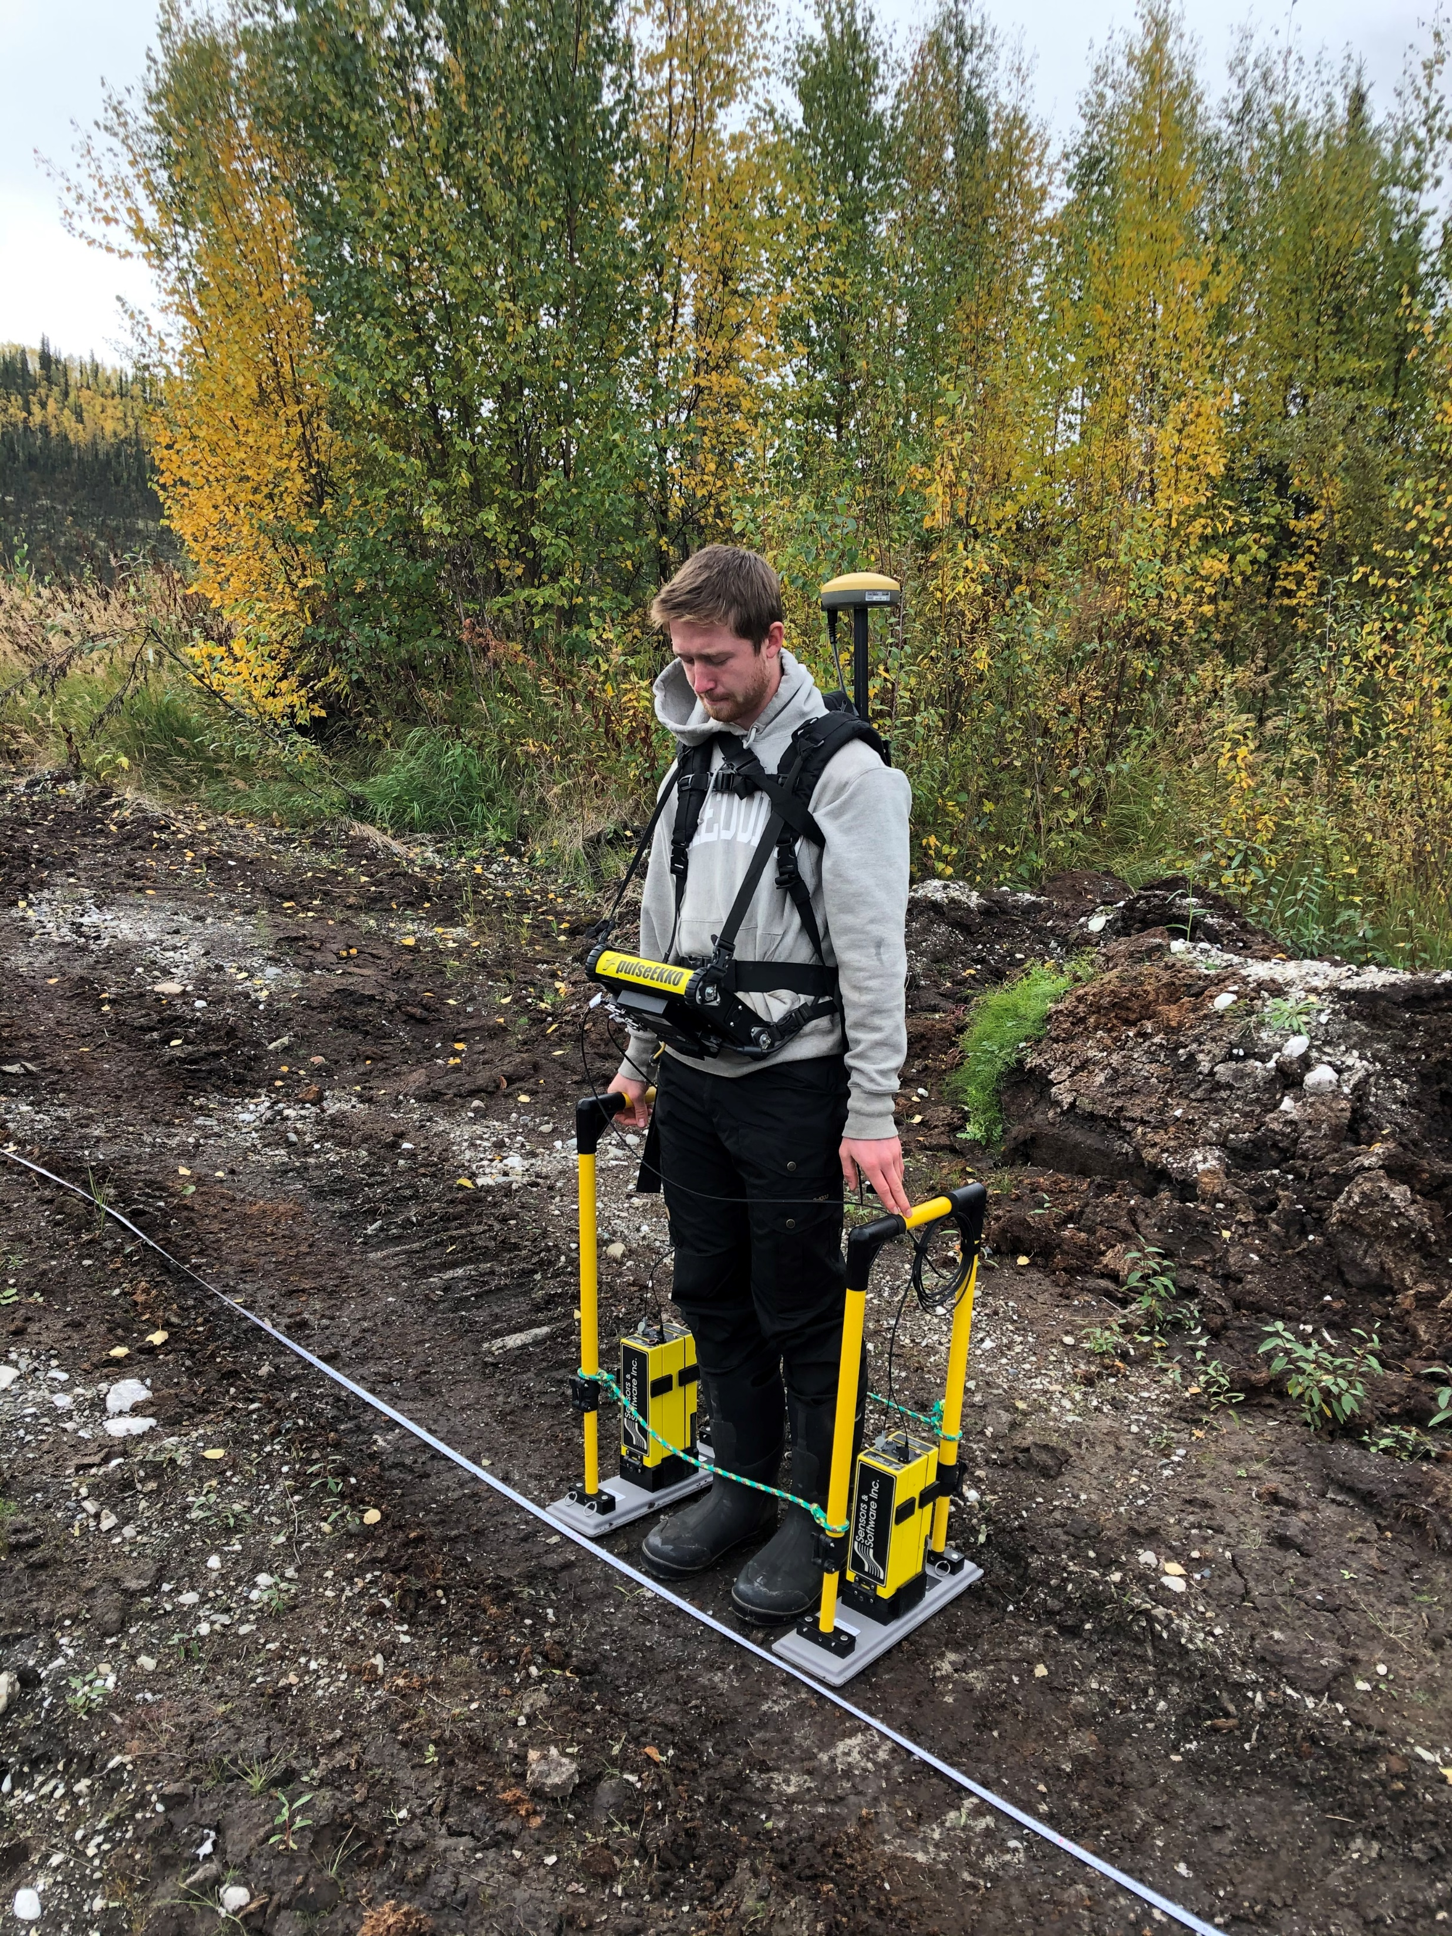
Figure 1: Field survey of 2020 GPR project, left is MALA GX system with 160 MHz shielded antenna, right is PulseEKKO with 200 MHz antenna.

Slide 7
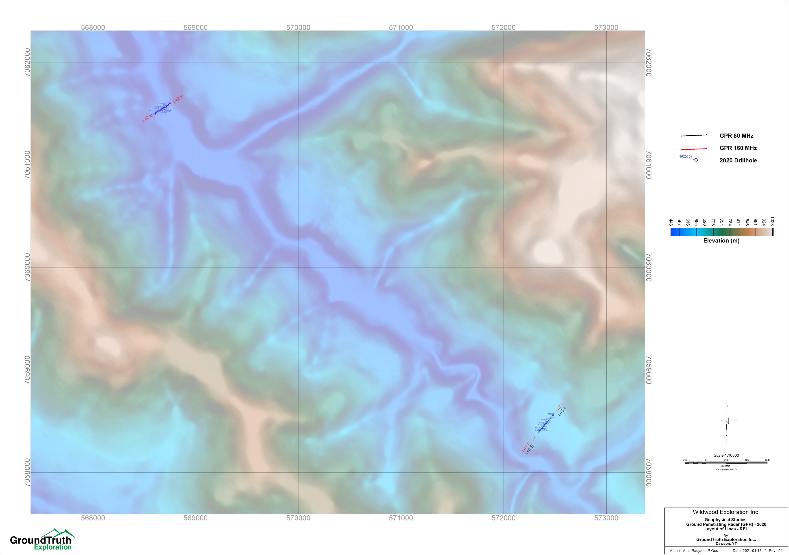
Figure 2: REI project, layout of GPR northern lines.

Slide 8
Data processing and Results:
All raw data are converted to SEG-Y format and imported to Geosoft for georeferencing and further processing. After QC/QA, the continuous measurement mode data are decimated to achieve 10cm spacing intervals.
Velocity analysis (semblance velocity) performed on Common Mid-Point (CMP) datasets collected by PulseEKKO systems. The CMP velocity analysis for one selected test location measured using a 100 MHz antenna is presented in Figure 3.
GPR depth sections are processed by conversion of time sections and assuming a constant radar velocity. Radar velocity is a function of dielectric permittivity of subsurface materials and is related to the ice content. Sediments with low ice contents typically have low radar velocity value and vice versa (i.e. 0.065 m/ns for unfrozen wet sandy/silty sediments and 0.10 for frozen saturated sandy/gravel sediments). The radar wave velocity of 0.085 m/ns is selected from the velocity spectrum of CMP data for time to depth conversion.
The GPR depth sections along 2 drill lines are plotted with downhole geology logs. Figure 4 to Figure 6 represents GPR sections with a primary interpretation. The reflectors were mapped by a quick visual evaluation of phases on the GPR time section first, then on the depth section. This interpretation of radar reflectors is subject to levels of errors and uncertainty associated with the estimated radar velocity for time to depth conversion of GPR data.

Slide 9
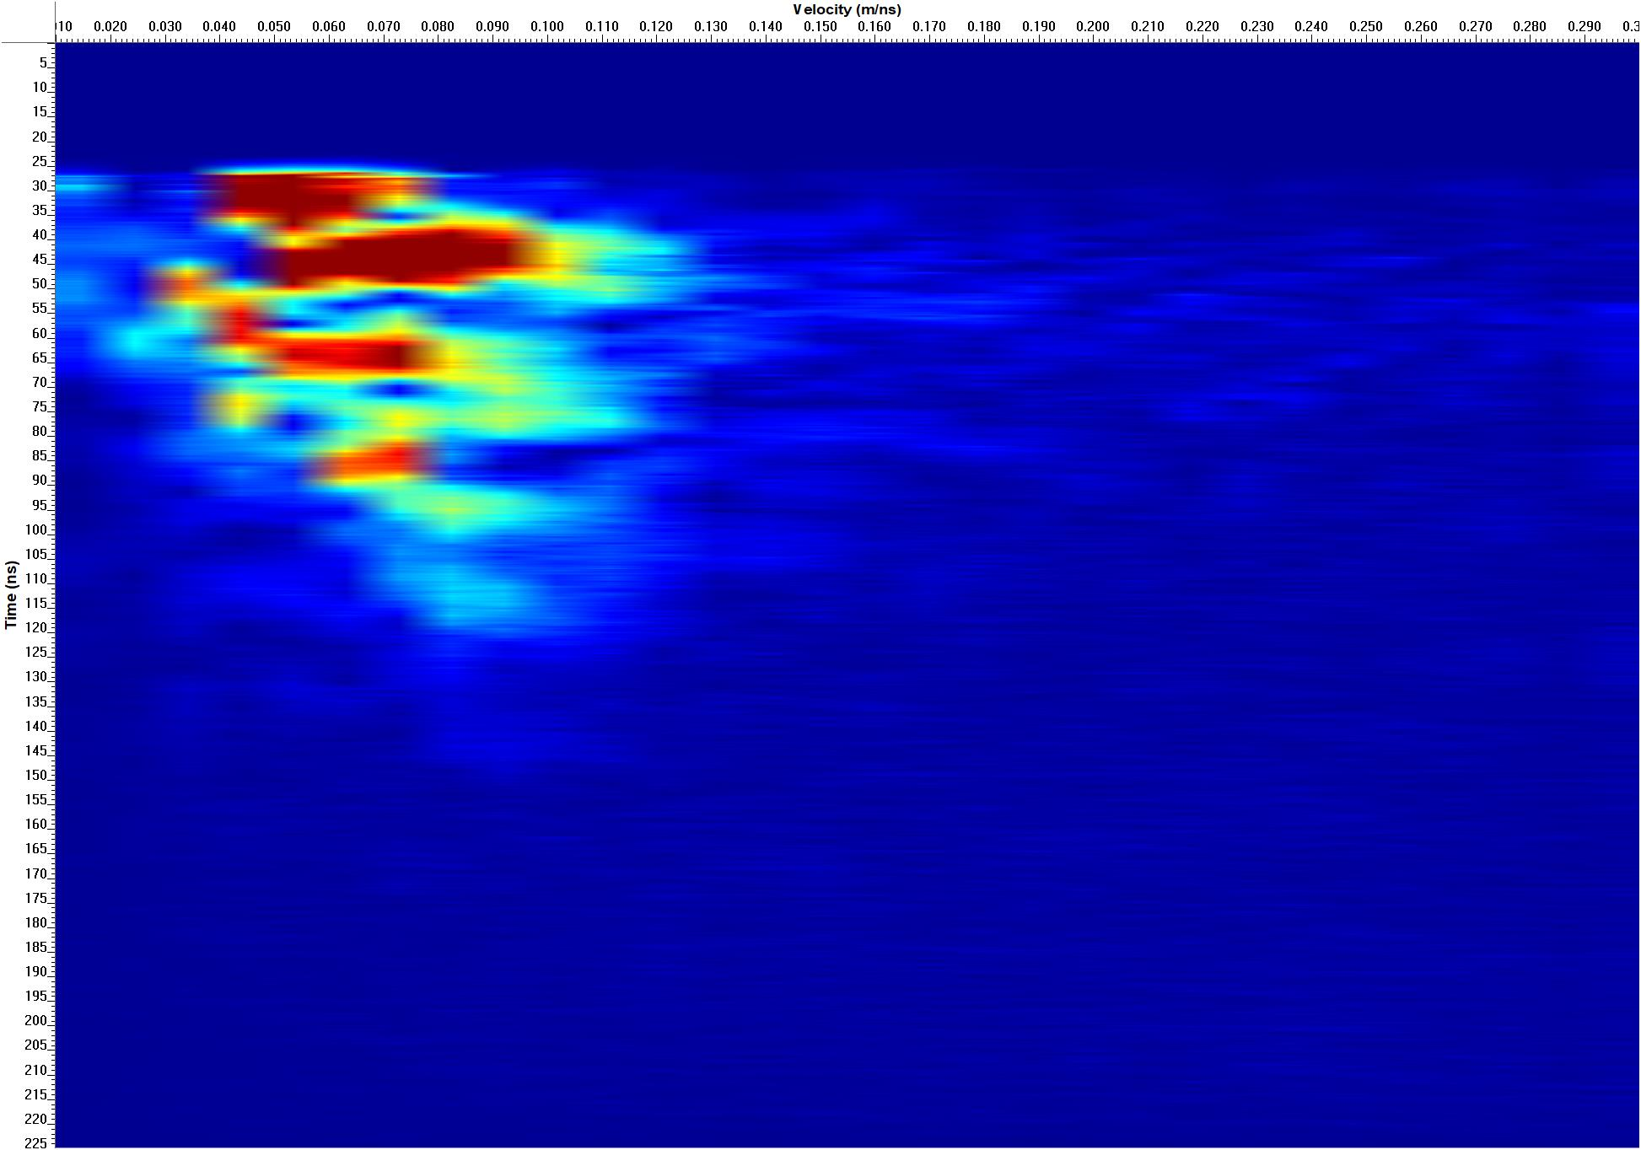
Figure 3: Velocity analysis (semblance velocity) performed on CMP data collected by PulseEKKO systems using a 100 MHz antenna.

Slide 10
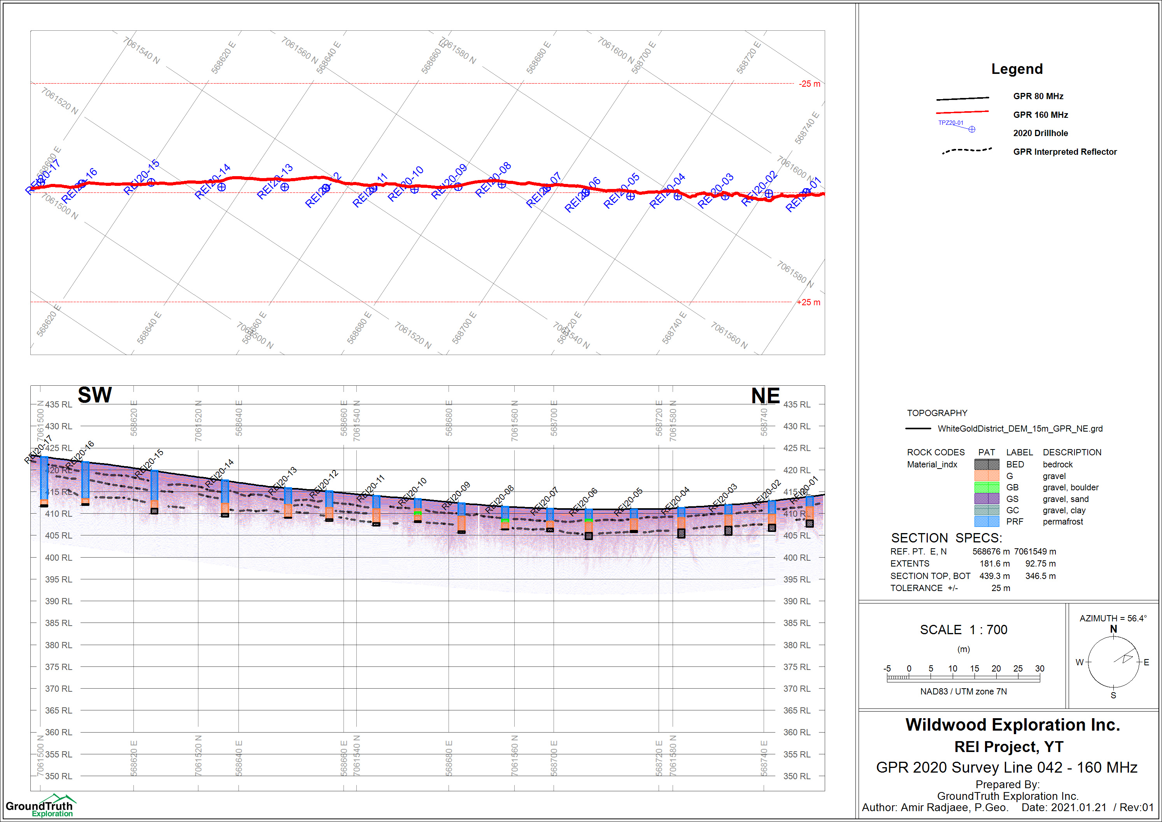
Figure 4: REI 2020 GPR survey, section for line 42 with 160 MHz antenna.

Slide 11
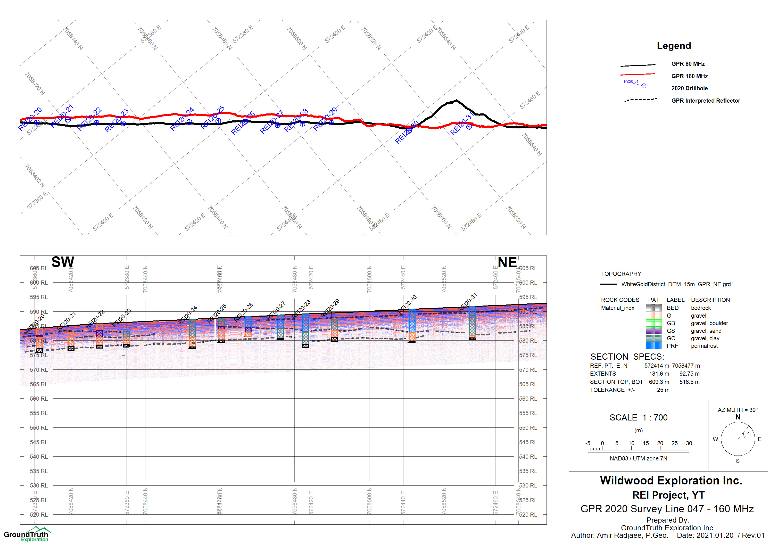
Figure 5: REI 2020 GPR survey, section for line 47 with 160 MHz antenna.

Slide 12
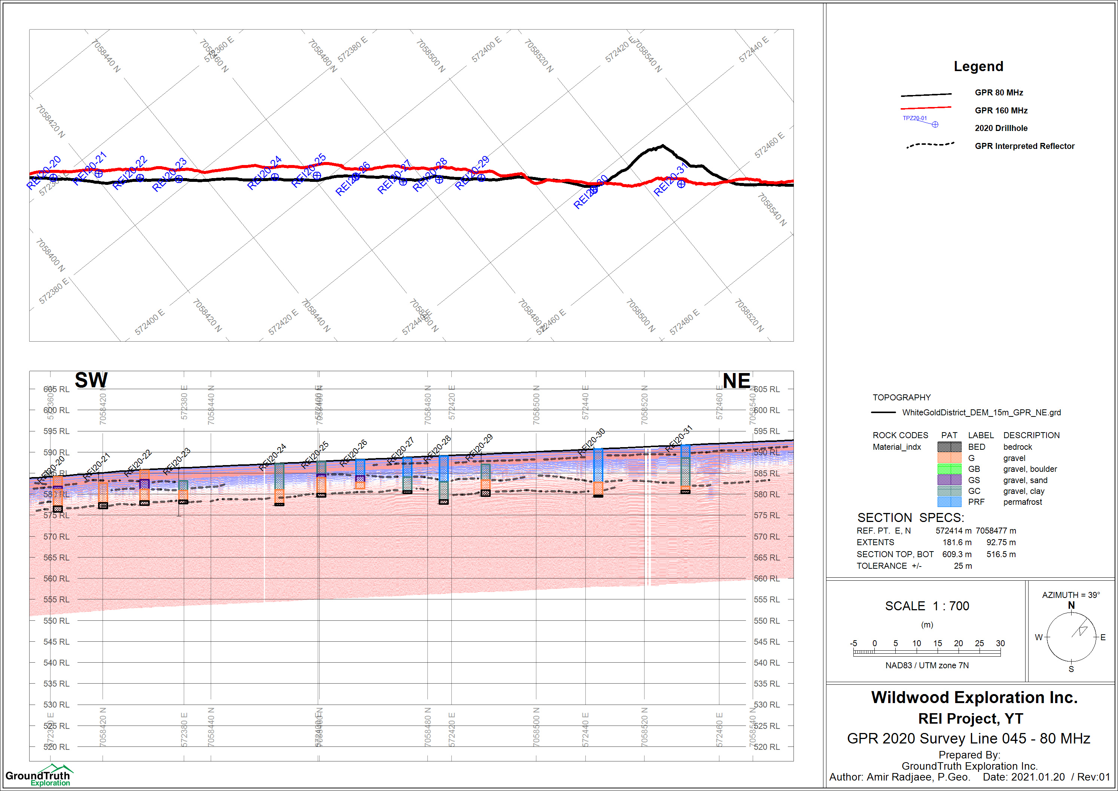
Figure 6: REI 2020 GPR survey, section for the central parts of line 45 with 80 MHz antenna.

Slide 13
Conclusion and recommendations:
GPR technology is used to identify the contacts between frozen and thawed zones in permafrost, and mapping the bedrock surface and sedimentary stratigraphy of placer deposits. The method is gaining acceptance as standard practice for reconnaissance alluvial gold exploration.
A variety of sediment structures such as channel fills and bedrock surfaces are commonly identified. In the survey area, penetration with the radar is generally moderate and frequently exceeds 10 m using an 80 MHz system. A high-resolution section acquired using a 160 MHz system with proper depth of penetration.
One of the most successful applications for the GPR method in this study is the ability to image the details of subsurface stratigraphy features continuously. Radar images have shown that the layering boundaries are surprisingly comparable with borehole logs in most lines. These abrupt changes in horizon elevations are generally undetectable by drilling at any economic spacing.
Some advanced data processing steps, such as lateral stacking of GPR traces and bandpass filtering, are recommended as further works.

Slide 14
Deliverables:
Maps and sections in jpg format
Layout of lines in shapefile format
Raw instrument data files
Presentation report
References:
De Pascale J.P., Pollard W.H., Williams K.K., 2008, Geophysical mapping of ground ice using a combination of capacitive coupled resistivity and ground-penetrating radar, Northwest Territories Canada, JGR, 113, F02S90 1-15.
Francke J., Yelf R., Applications of GPR for surface mining, Advanced Ground Penetrating Radar, 2003. Proceedings of the 2nd International Workshop.
Kulyandin G.A., Fedorova L.L., Savvin D.V., Prudetskii N.D., 2016, GPR mapping of bedrock of alluvial gold deposits in permafrost, 16th International Conference of Ground Penetration Radar (GPR).

