Slide 1
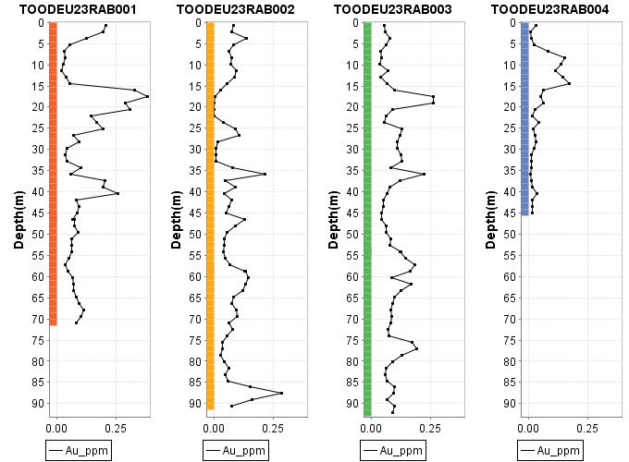
Figure 11: RAB drill downhole plot showing gold values along the x-axis and depth values plotted along the y-axis in meters.

Slide 2
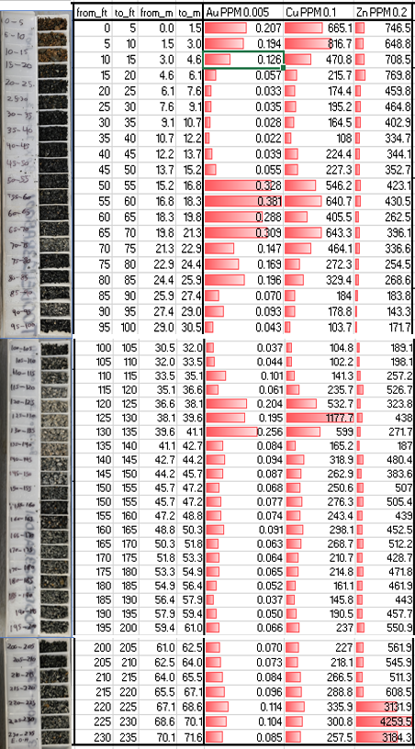
Figure 12: Chip photos alongside assay results for Au, Cu, and Zn on TOODEU23RAB001.

Slide 3
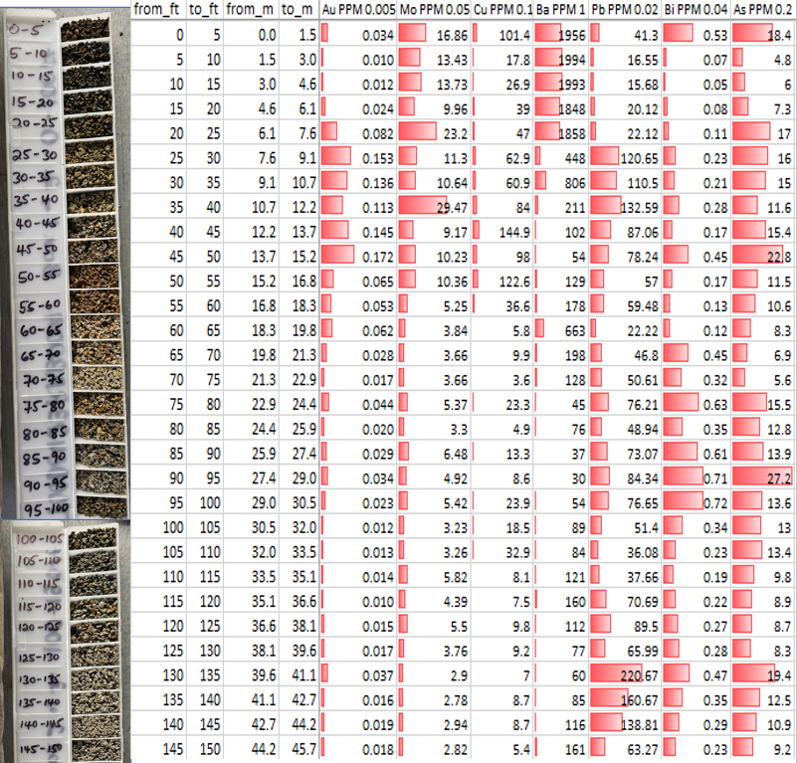
Figure 13: Chip tray photos alongside assay for Au, Cu, Mo, Bi, Pb, Ba and As on DEUTOO23RAB004.

Slide 4
Table 5:2023 RAB drilling Summary Statistics

Slide 5
Figure 14: Box and whisker plots showing gold and copper results

Slide 6
Figure 15: Box and Whisker plots showing lead and zinc results from the 2023 RAB drilling.

Slide 7
Figure 16: Box and whisker plots showing bismuth and arsenic results from the 2023 RAB drilling

Slide 8
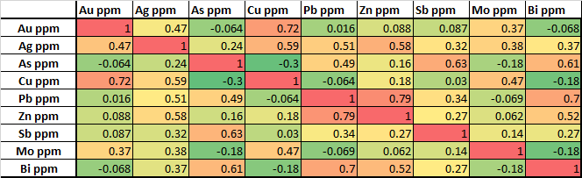
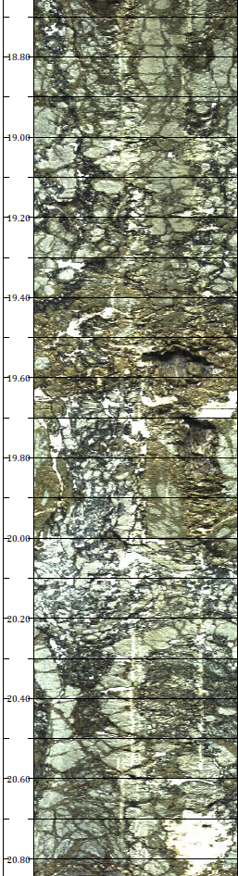
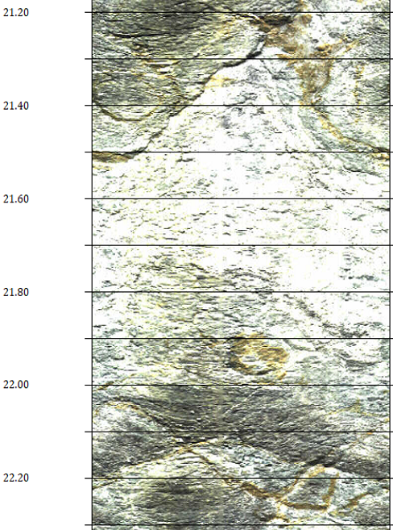
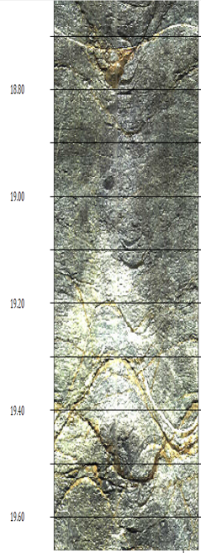
Table 6: Correlation table of key elements from 2023 RAB drilling assay results.
Figure 17: OTV imagery from TOODEU23RAB001 from 21.2-22.2m showing intense sericite(?) alteration.
Figure 18: OTV imagery from TOODEU23RAB001 from 18.6-19.6m showing moderate to strong bleaching and oxidized fracturing within gold bearing zone.
Figure 19: Veined, brecciated and altered zone within TOODEU23RAB002 which returned low gold values relative to surrounding rock.

Slide 9
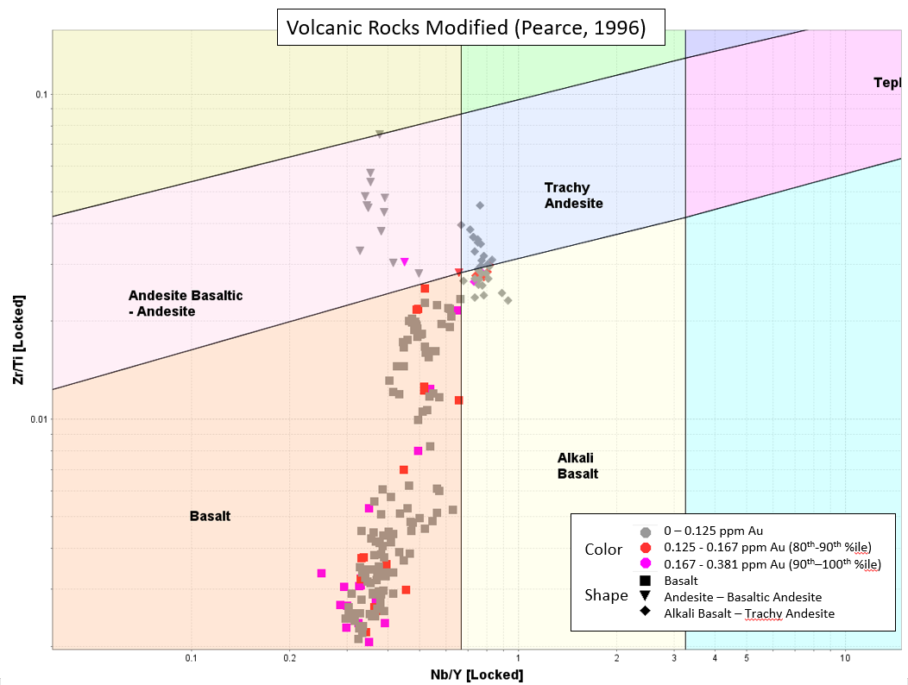
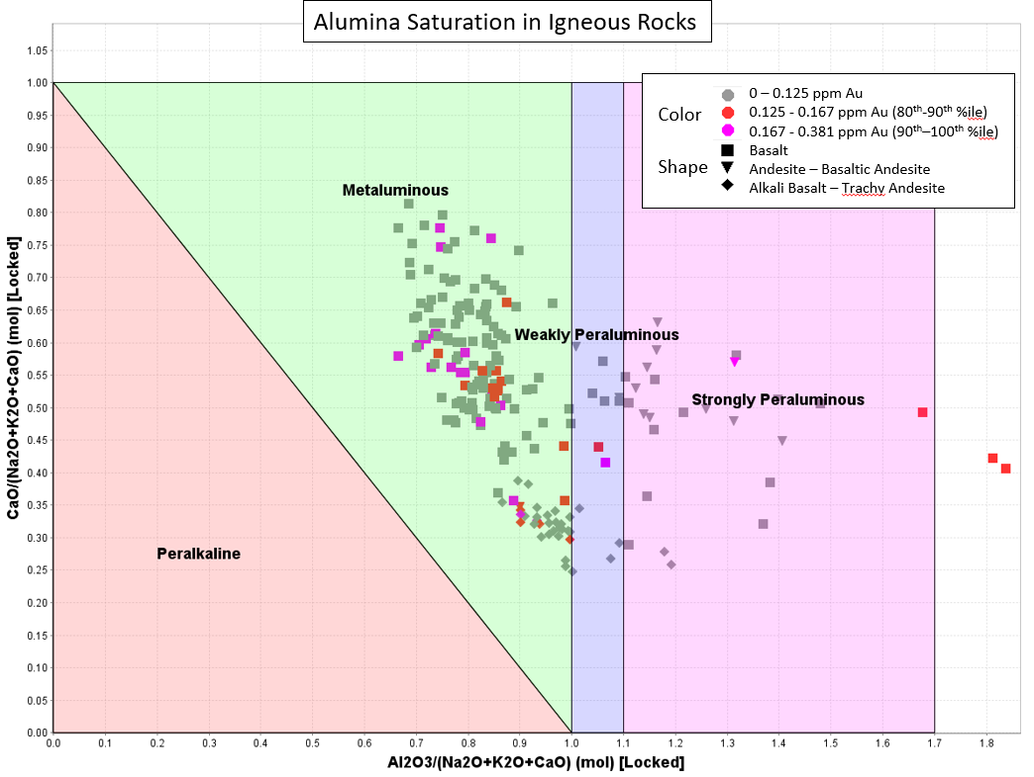
Figure 20: Volcanic Rock classification chart using immobile elements as proxy for TAS diagram (Pearce, 1996).
Figure 21: Alumina Saturation in Igneous Rocks (Barton and Young, 2002)

Slide 10
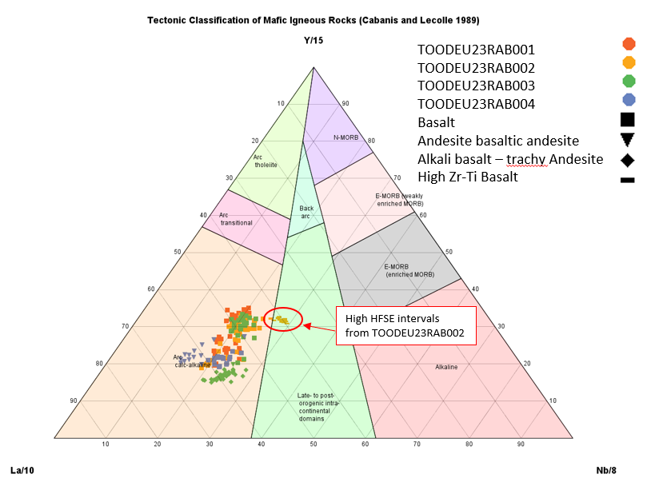
Figure 22: Tectonic classification of mafic igneous rocks showing a distinction between rocks encountered on the Deuce target during the 2023 RAB drilling program.

Slide 11
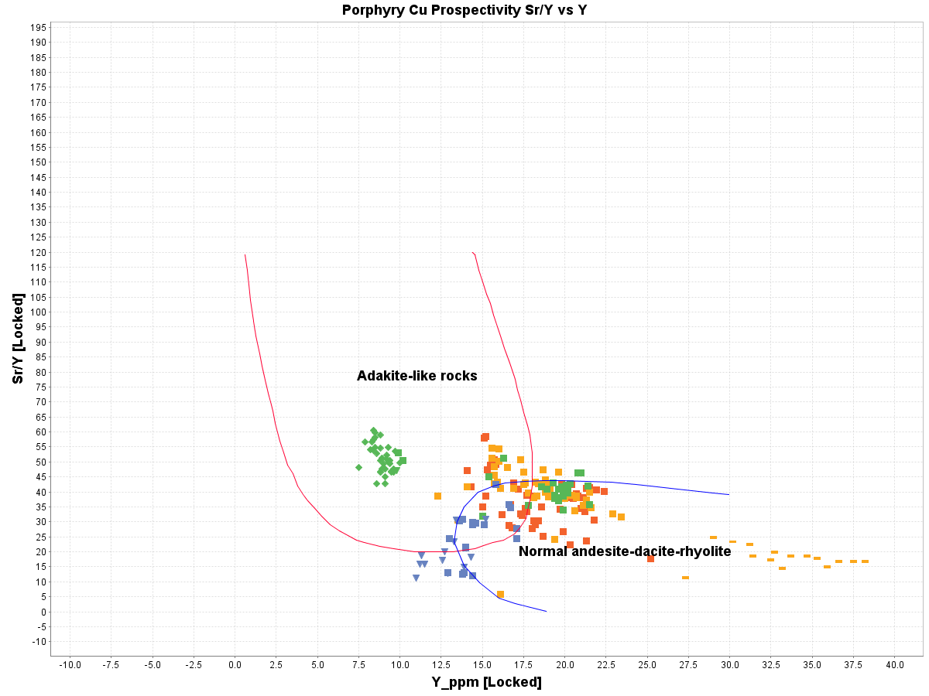
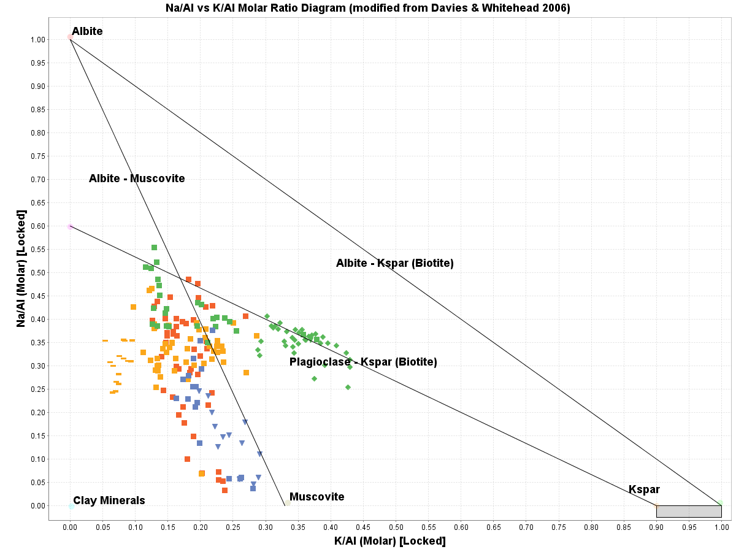
Figure 27: Porphyry prospectivity diagram showing a series of Trachy-Andesitic to Alkali Basalts (primarily unit 3) sampled from TOODEU23RAB003 carry a geochemical signature of that of adakite-like rocks. Note, this cluster tends to carry Cu-Au mineralization (Richards et al., 2012).
Figure 28: Na/Al vs K/Al molar ratio diagram showing a potassic character in adakite-like rocks sampled from TOODEU23RAB003.

